Slide 1
Riccardo Miccini
uC software structure
Sensors reading
Motor control system
Remote control dispatcher
Path management
Debug system

Slide 2
uC software structure

Slide 3
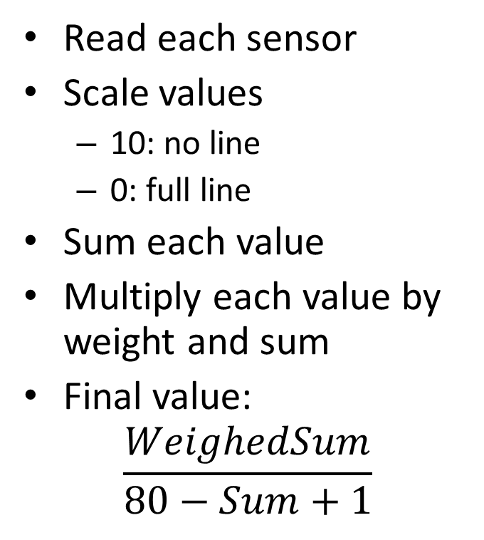
Sensors reading
Read each sensor
Scale values
10: no line
0: full line
Sum each value
Multiply each value by weight and sum
Final value:
$$\frac{WeighedSum}{80−Sum+1}$$

Slide 4
Motor control system
Calculate speeds
Calculate bias
Line detection
Motors speeds difference
Calculate errors
Reference, current speed, bias
Calculate PWM values upon errors

Slide 5
Remote control
Parameters:
Kp (for each motor)
Ki
Kw
Ks
Sampling frequency Fs
# averages
Reference speed
Sensors weights
Path stage
Actions:
Increase speed
Decrease speed
Turn left/right
Set direction (forward/backward)
Break
Print infos

Slide 6
Path management: stages
0. Beginning
Entering the path
Line gap
Start semicircle
Semicircle finished
Speed increment
Stop and go straight
Front wall - turn
No side wall - turn
Side wall detected
No side wall – turn
Front wall – turn
Front wall – stop
Finish

Slide 7
Debug system
Debug types:
Sensors
Sensors thresholds
Motors
Line parameters
Distance
Communication
Synchronous
X-Bee (transparent mode)
Command syntax:
m‗1‗155‗15‗12
Source
Source identifier
Val1, Val2..

